Slide 1
Stay apparatus
Stay apparatus :
"Horses can stand on their feet for long periods, much longer than other domestic animals and this enables them to rest. Features allow horses this advantage called the stay apparatus. The stay apparatus consists of ligaments and tendons that stabilize all the joints of the forelimb and the lower joints (the fetlock and pastern) of the hind limb. Minimal muscular activity is needed to hold tension on these ligaments and tendons, which in turn prevent flexion of the joints and collapsing of the leg. This allows the horse to balance its weight on its legs .

Slide 2
This is further divided into the suspensory apparatus .
Suspensory Apparatus
'Interosseous medius/Suspensory ligament' : Proximally, this attaches to the distal row of carpal bones and metacarpus. It runs distally on the palmar surface of the metacarpal bone and then bifurcates proximal to the metacarpophalangeal (fetlock) joint, with a small branch connecting to each sesamoid. It then continues distally on the dorsal surface of the proximal phalanx and joins the common digital extensor tendon, which continues to insert on the middle and distal phalanges.
Collateral sesamoid ligaments - connect the abaxial surface of the sesamoid to the metacarpus and proximal phalanx.
Palmar ligaments - connect the sesamoid bones together.
Distal sesamoidean ligaments - connect the sesamoids to the proximal and middle phalanges. This ligament can be seen as a direct continuation of the interosseous muscle with the sesamoids emdedded in it.

Slide 3
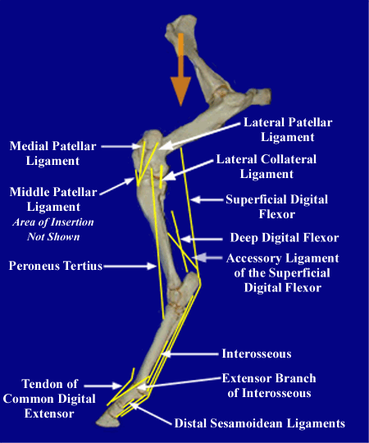

Slide 4
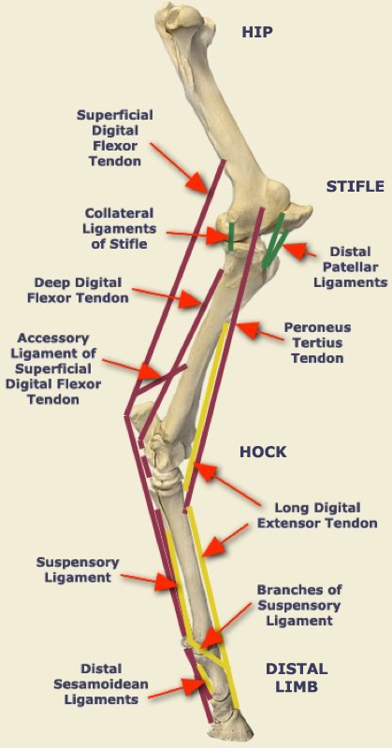

Slide 5
Horns
The horns of domestic ruminants(cow , sheep and goats ) have osseous bases provide by corneal processes of frontal bones . Horns are permanents and grow continuously after their first appearance soon after birth . They are very greatly in size, form, and curvature. The root or base of the horn , has a thin edge which is continuous with the epidermis. Near the root the horn is encircled by variable rings. Toward the apex the thickness of the horn increases till it becomes practically a solid mass. The horn consists mainly of tubes which are very close together, except at the rings, where there is more intertubular horn. The matrix of the horn is united to the horn process by periosteum which is traversed by numerous blood-vessels.

Slide 6
